Slide 1
Maths
Unit 1.1 – Place Value
25.08.2026
WALT: Round numbers with two decimal places to the nearest tenth or whole number.

Slide 2
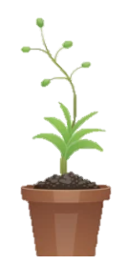
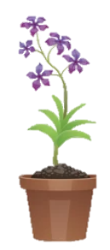
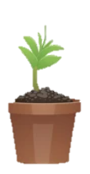
WALT: Round numbers with two decimal places to the nearest whole number.
With support, I can round decimal numbers.
Independently, I can round decimal numbers.
I can think of my own game to help teach rounding decimal numbers.

Slide 3
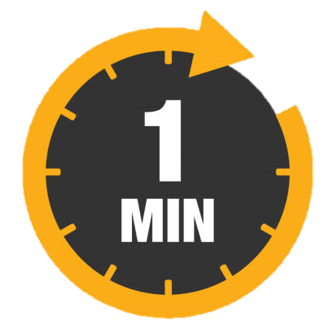
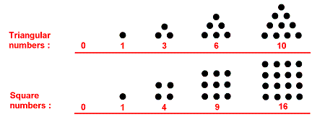
Retrieval Practice – Square and Triangular Numbers
WALT: Round numbers with two decimal places to the nearest whole number.
Explain the difference between square and triangular numbers.
Triangular numbers are made by adding consecutive counting numbers, forming a triangle dot pattern.
Square numbers are made by multiplying a whole number by itself. This makes a grid array.

Slide 4
Starter – Round this number to the nearest…
WALT: Round numbers with two decimal places to the nearest whole number.
a) 10
b) 100
c) 1,000
8,750
8,745
8,700
9,000

Slide 5
Rounding to the nearest whole number
WALT: Round numbers with two decimal places to the nearest whole number.
Rounding makes it easier to describe and understand numbers.
When we round a decimal number to the nearest whole number, we need to look at the tenths place value column.
This will tell us which way we round.
3.28
We need to look at the tenths
3.28 rounded to the nearest whole number is 3

Slide 6
Let’s round this decimal number together to the nearest whole number.
WALT: Round numbers with two decimal places to the nearest whole number.
5.86
6

Slide 7
Now try these by yourself.
WALT: Round numbers with two decimal places to the nearest whole number.
7.83
3.49
12.5
13
8
3

Slide 8
Rounding to the nearest tenth
WALT: Round numbers with two decimal places to the nearest whole number.
Rounding makes it easier to describe and understand numbers.
When we round a decimal number to the nearest whole number, we need to look at the hundredths place value column.
This will tell us which way we round.
3.28
We need to look at the hundredths
3.28 rounded to the nearest tenth is 3.3

Slide 9
Let’s round this decimal number together to the nearest tenth.
WALT: Round numbers with two decimal places to the nearest whole number.
5.76
5.8

Slide 10
Now try these by yourself.
WALT: Round numbers with two decimal places to the nearest whole number.
7.13
3.45
12.03
12.0
7.1
3.5

Slide 11
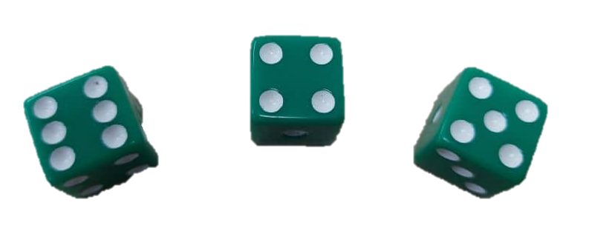
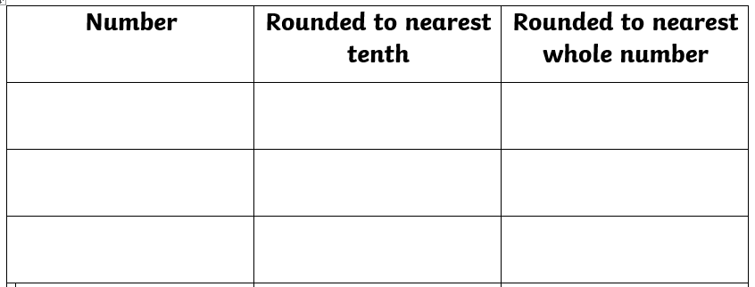
In pairs roll three dice Use the dice to create a number with two decimal places. Round the number to the nearest tenth and whole number.
WALT: Round numbers with two decimal places to the nearest whole number.
6.45
6.5
6
Can you think of your own game to teach / practice rounding decimals?

Slide 12
WALT: Round numbers with two decimal places to the nearest whole number.
With support, I can round decimal numbers.
Independently, I can round decimal numbers.
I can think of my own game to help teach rounding decimal numbers.

Slide 13
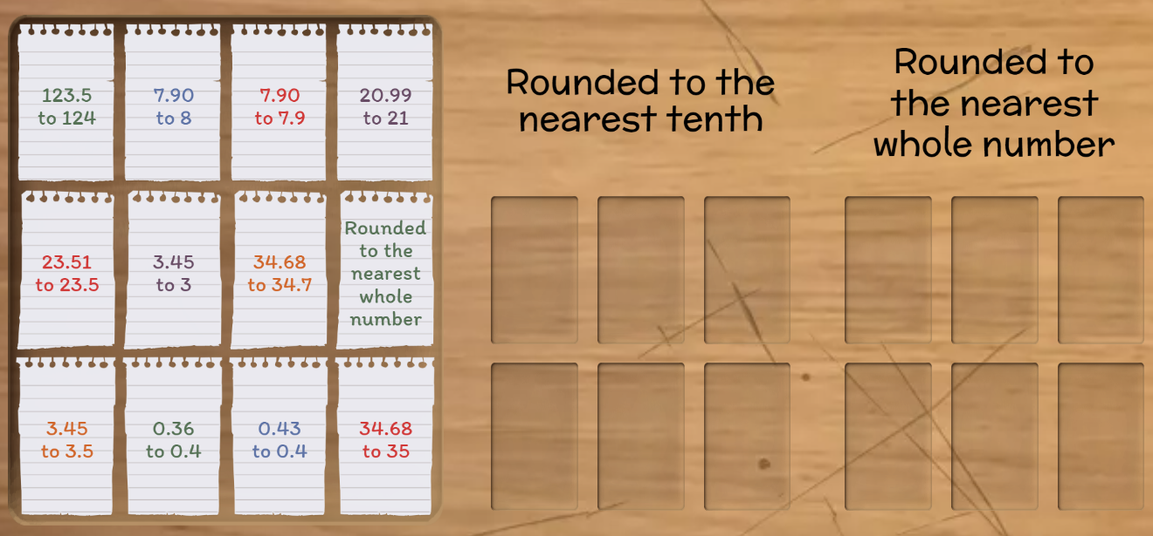
WALT: Round numbers with two decimal places to the nearest whole number
Plenary - https://wordwall.net/play/13088/125/5562

